Slide 1
Attention and Listening Skills

Slide 2
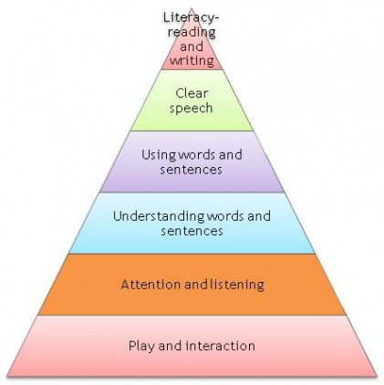

Slide 3


What are attention and listening?
Attention – being able to stay at a task for an appropriate period of time
Listening – to take on verbal information from others (this is different to hearing)

Slide 4
Development of Attention
Level 1 | Easily distracted, flits
Level 2 | Only attends to activity of own choosing, single channelled
Level 3 | Can shift attention from task to listening with adult help
Level 4 | Still needs to stop task to listen/look but can do this on their own
Level 5 | Can listen to speaker at the same time continuing with task
Level 6 | Auditory, visual and manipulatory channels are integrated

Slide 5




Types of Listening
Pretend listening – look as though you are listening but not taking on board information
Selective listening – listening to some parts of information
Attentive listening – listening to learn and understand
Empathic listening – listening to understand and respond to others

Slide 6
Attention and Listening as Adults
Who starts thinking about dinner when you are finding the topic boring / someone has spoken for too long / you are not understanding?
Who turns down the music in the car to ‘help you see’ when you are lost / in heavy rain?
Who gets distracted by the computer / TV when someone is telling you about their day?

Slide 7
Considerations
Children who find it hard to remember can seem like they have not been listening; you need to work on memory too
Children learn more when they are involved in the activity – give them time to talk as well as listen e.g. when reading a story leave off the last word for them to join in
Children can move and listen at the same time – if you make them stay still their attention is on this rather than on the information they are being given.
  For example, have a conversation about what you did this morning, but try not to blink – were you able to listen well?

