Slide 1
Helping to develop vocabulary
River Speech and Language Resource Based Provision

Slide 2

What is vocabulary?
Vocabulary is made up of two parts.

Slide 3

Vocabulary: Part 1
The range of words that a child can understand when he/she hears or reads them.
This is called receptive vocabulary.

Slide 4

Vocabulary: Part 2
The range of words a child can use when he/she speaks.
This is called expressive vocabulary.

Slide 5
A child needs to understand a word first, before they can use it.
Expressive vocabulary
Uses the word
Receptive vocabulary
Expressive vocabulary
Receptive vocabulary
Understands a word
Understands the word
Uses the word
Therefore we must help a child to learn the meaning of a word, before we work on expression, or expect the child to say the word.

Slide 6
Why is vocabulary important?
An understanding and use of a wide vocabulary is needed to succeed in school … and in life.
To progress with reading a child will need to understand the words they are seeing on the page.
To progress with writing a child will need a wide and varied bank of words to draw from.
To understand other subjects such as maths and science, a child will need to understand the words being used.
A wide range of words is needed for a child to successfully express their needs, wants and ideas, and to negotiate with other children.

Slide 7
How families support word learning
Families are a child’s first teacher of words.
Families have a crucial role in supporting ongoing word learning.
Families are able to expose the child to words within a broader range of settings and experiences. This builds stronger understanding and use of words.
When families and school work together to support vocabulary, the child will show the greatest achievement in word learning.

Slide 8
How do we learn new words?
When we hear a new word we link a spoken label to a meaning.
e.g. A parent points to a dog and says ‘dog’, child links the word to the creature he/she can see.
‘Concrete words’ e.g. objects, animals and food, that we can see, touch, smell or taste are easier to learn.
‘Non concrete words’ e.g. action words, can be more difficult to learn, since they may only last a few seconds e.g. ‘jump’.

Slide 9
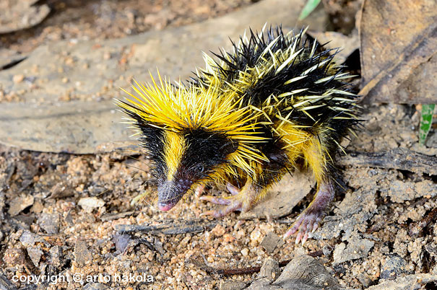
Lowland Streaked Tenrec
Lives in Madagascar
Lowland – heard that term before when reading about gorillas.
Looks like a small hedgehog
Has the number 10 in it’s name
‘ten’-rec
Yellow and black stripes like a bee
Rubs spikes together to make sound

Slide 10

How do we learn words? … continued
As children learn new words, they make links to the words they already know.
These links help the child to store the word successfully.
If the word is stored successfully, it will be easier to find when the word is needed in the future.

Slide 11

Top tips for supporting word learning at home
Have fun with words!
We all know children learn best when they are enjoying themselves.
Playing word games regularly will encourage an interest in words and also build on word learning skills.
Understanding first … saying second
Help your child to understand what the word means before expecting them to say it. Talk about the word and show how it can be used. Use comments rather than questions to do this.

Slide 12

Further top tips …
Repeat … repeat … repeat
The more times a child hears a word the more likely they are to learn it. This is particularly the case for children with speech and language difficulties.
Actions can speak louder than words
Use actions, gestures, signs and/or facial expressions to to show the meaning of words. You can also add meaning by the way you say a word e.g. saying ‘terrified’ in a shaky voice.

