Slide 1
Memory

Slide 2
Memory … three different types
Sensory memory
Working memory
Long term memory

Slide 3
Sensory memory
Where the incoming information that we see and hear is briefly stored for up to a few seconds.
Information will then be moved to Working Memory or discarded.

Slide 4
Working Memory
Where we hold information we want to attend to for anything from a few seconds to a few minutes
e.g. remembering the sum 3 + 4 while we work out the answer. INSTRUCTIONS
Short-term memory store where a limited amount of information can be kept, whilst it is used.
The amount of information that can be in our working memory at any one time is called the memory span.

Slide 5
Long-Term Memory
Where information can be kept from anything from a few minutes to years.
Information can also be moved to and from Working Memory and Long Term Memory

Slide 6

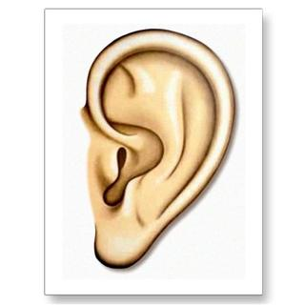
Sensory
Memory
Short-Term
Working Memory
Long-Term Memory
Sensory information
Attention

